Slide 1
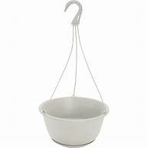
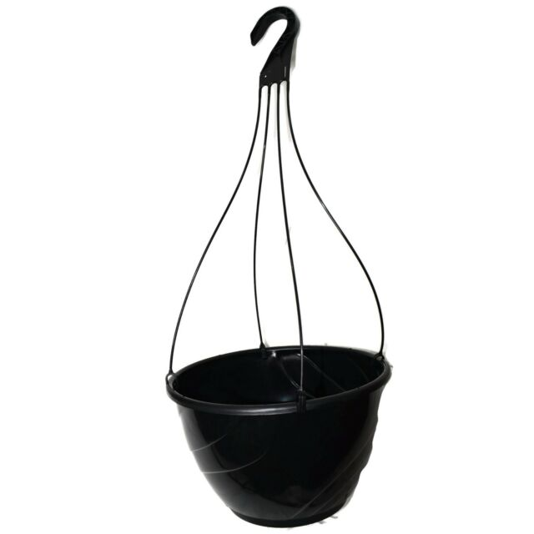
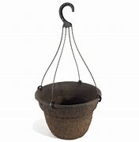
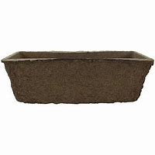
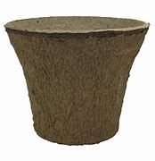
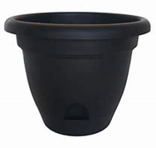
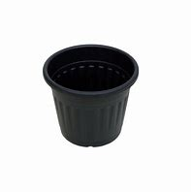
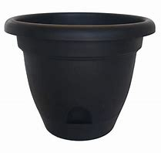
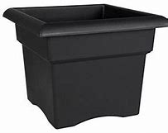
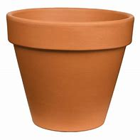
Container Examples
All container images are not exact and not to scale. Examples only.
7 in White plastic Hanging Basket
11 in Black plastic Hanging Basket
12 inch fibre Hanging Basket
Fibre Window Box insert
12 “ Fibre Urn Liner Pot
13 inch Round Planter Black
14 inch Square Planter Black
18 inch Round Planter Black
10 inch Round Terracotta pot
10 inch Round Black Plastic
pot

